Slide 1
Intro to NLP
Project : Text Fluency
Team Members
Shravan Sharma 2021201058
Vineet Agrawal 2021201049
Sankalp Thakur 2021201042

Slide 2
Introduction
Text fluency is an estimate of text's quality, readability, accuracy, and comprehension. When text is generated by machine it is prone to be erroneous and must be corrected by human intervention. To check if the text generated is of good quality fluency provides a measure.
In this project we try to classify the text data into 3 classes Fluent, neutral and non fluent .We do this using supervised algorithms. We use both traditional as wel as deep learning approaches for this purpose.

Slide 3
Dataset
We used Microsoft Compression Dataset. This dataset contains sentences and short paragraphs with corresponding shorter versions.
There are up to five compressions for each input text, together with quality judgements of their meaning preservation and grammaticality.
The dataset contains around 23 thousand shorter version which are unique.
Average meaning and grammar scores for every sentence range from 1 to 3. These scores are average of scores given by human judges.

Slide 4
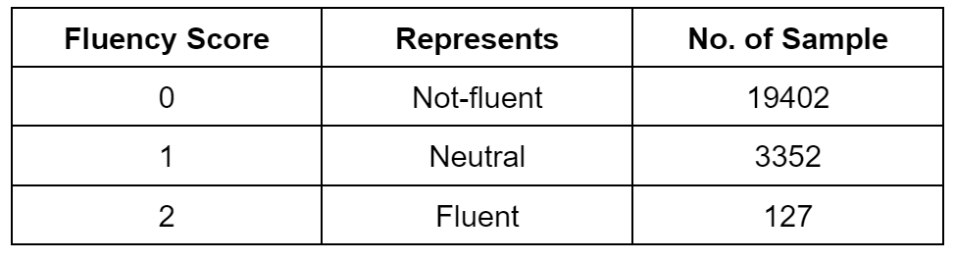
Methodology
We take on this problem as multi-class classification, with classes being FLUENT, NEUTRAL and NOT FLUENT.

Slide 5
Methodology
First we calculate metrics for every sentences.We use BLEU score , ROUGE-L , ROUGE-N, n-gram-overlap and find the correlation between different values of weighted sum of avg meaning and grammar.
The weights that has highest amount of correlation are chosen to calculate fluency.
We found highest positive correlation was with following weightage

Slide 6
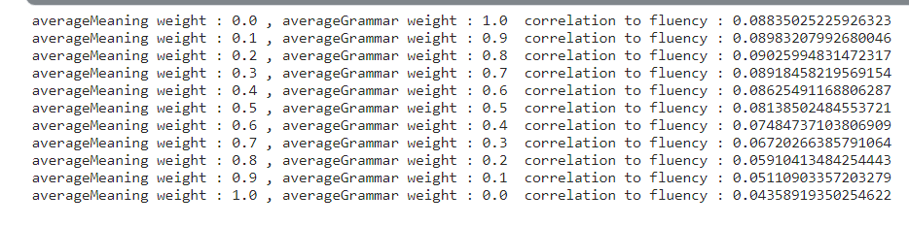
Methodology

Slide 7
Methodology
We did minimal preprocessing because fluency of sentence must be calculated as it is for the sentence. The scores were given by humans according to the output generated by the algorithms. Tampering with the punctuation or stop words would make the data unreliable.
So we only converted the sentence to lower case and tokenized the sentences.
We made the train test split of ratio 2:1 .

Slide 8
Methodology
Since the data was Unbalanced we used 3 sampling techniques to balance the data.
These techniques are:
SMOTE
SMOTE Borderline
ADASYN

Slide 9
SMOTE (Synthetic Minority Oversampling Technique)
SMOTE is an oversampling technique that generates synthetic samples from the minority class. It is used to obtain a synthetically class-balanced or nearly class-balanced training set, which is then used to train the classifier. The SMOTE samples are linear combinations of two similar samples from the minority class

Slide 10
Borderline SMOTE
This algorithm starts by classifying the minority class observations. It classifies any minority observation as a noise point if all the neighbors are the majority class and such an observation is ignored while creating synthetic data . Further, it classifies a few points as border points that have both majority and minority class as neighborhood and resample completely from these points

Slide 11
ADASYN
ADASYN is a more generic framework, for each of the minority observations it first finds the impurity of the neighborhood, by taking the ratio of majority observations in the neighborhood and k.this impurity ratio is converted into a probability distribution by making the sum as 1. Then higher the ratio more synthetic points are generated for that particular point.

Slide 12
Methodology
We used 4 methods for classification.
Non-DL classifiers
Non-DL classifiers using POS Tagging
LSTM using GLove Embeddings
BERT Encoding

Slide 13
Non-DL classifiers
Converted tokenized text into Sequence and padded the sequences to get inputs of equal lengths.
Used 4 Classification algorithms:
Logistic regression
SVM
Decision Tree
XGBoost

Slide 14
Non-DL classifiers using POS - Tagging
Converted the text into Part of speech tags. And then used the same algorithms used in Text2Sequence method to classify the text.
Using Part of speech makes the data more generic and can potentially provide better results.
Tried TF-IDF but took to long to train due to large vocab size

Slide 15
LSTM using Glove embeddings
Created model using TensorFlow and added glove embedding to the model.
Used embeddings of size 300
Tried both LSTM as well as BI-LSTM.

Slide 16
BERT Encoding
Used BERT to get encoding for every word and then took mean to get embedding of a sentence giving a fixed size representation for every sentence.
Used FCNN to classify the data.

Slide 17
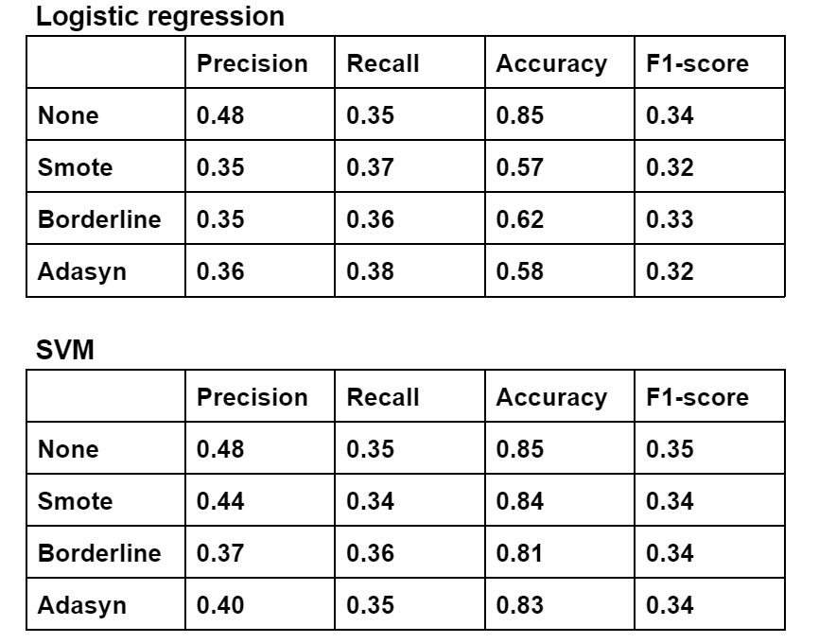
Analysis (Non-DL)

Slide 18
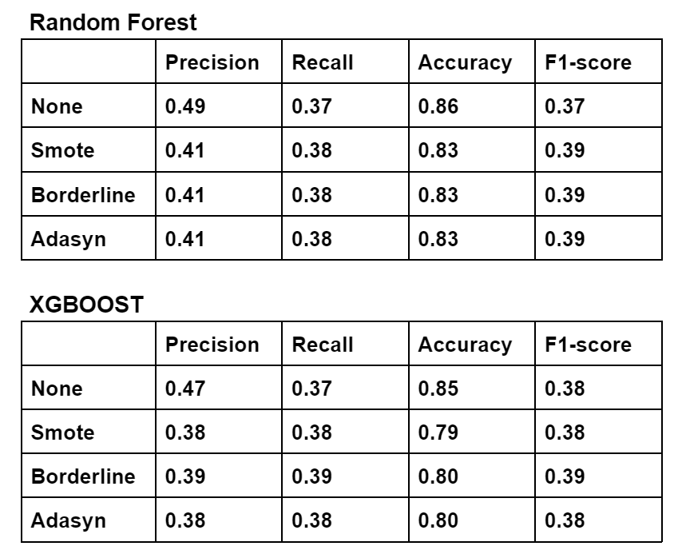
Analysis (Non-DL)

Slide 19
Analysis (Non-DL)
Logistic regression and SVM perform poorly on data
Tree based algo perform better.
While the accuracy is comparable, both XGBoost and Random Forest have better metrics than logistic regression and svm
Random Forest have better average precision while XGBOOST has better recall when oversampled using borderline

Slide 20
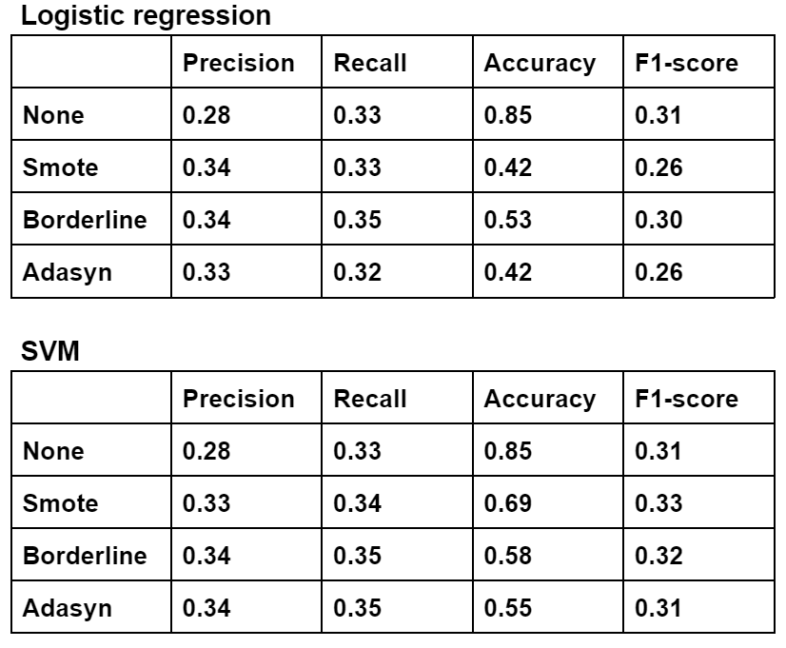
Analysis (Non-DL POS)

Slide 21
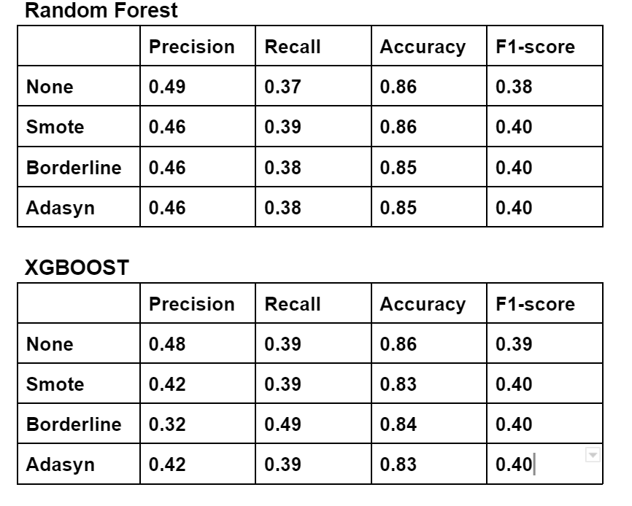
Analysis (Non-DL POS)

Slide 22
Analysis (Non-DL POS)
Again we see similar trend where Tree based algorithms outperform other 2 algorithms.
Using we get slightly better results when compared to previous method.

Slide 23
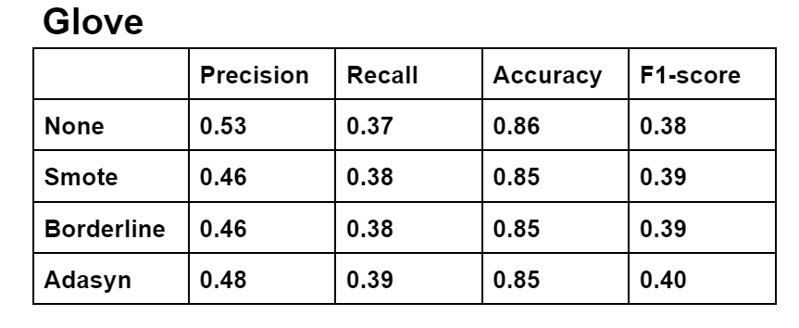
Analysis (GLove)

Slide 24
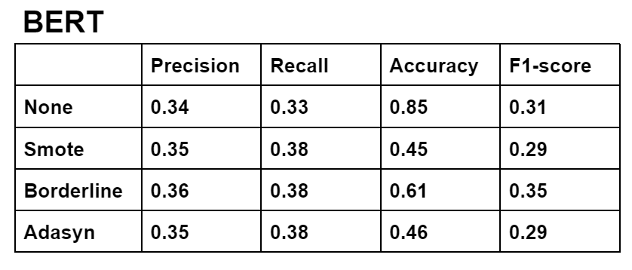
Analysis (BERT)

Slide 25
Analysis
LSTM with GLove performed better, just like XGBoost and Random Forest.
Best model was trained when using Adasyn sampling
Precision - 0.48 Recall - 0.39 and F1 score - 0.40 is best combination for model.
Bert Performed Poorly. Possible Reason - instead of taking individual word embeddings, mean of the word embeddings was assumed to be sentence embeddigs.

Slide 26
Conclusion
The dataset was highly imbalance and could not be efficiently divided into classes.
A better dataset required which has higher number of non fluent samples which are also distinguishable is required to achieve the task of fluency classification.
Over sampling helped to an extent but was not very beneficial.

